Slide 1
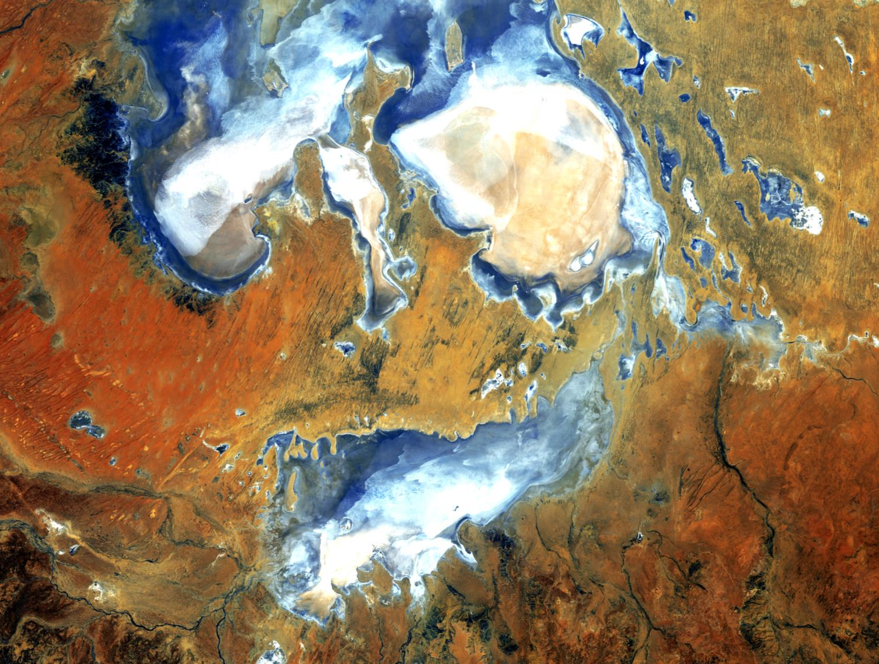



Making our water models climate change ready:
Are they up to the task?
TONY WEBER
14 May 2020
Notes:
Image: Lake Eyre. Deep in the desert country of northern SA, Lake Eyre is an ephemeral feature of this flat, parched landscape. When seasonal rains are abundant, water fills the lakebed to some degree. During the last 150 years, Lake Eyre has filled completely only three times. When brimming, it is Australia’s largest lake.
SOURCE: US Geological Survey.

Slide 2

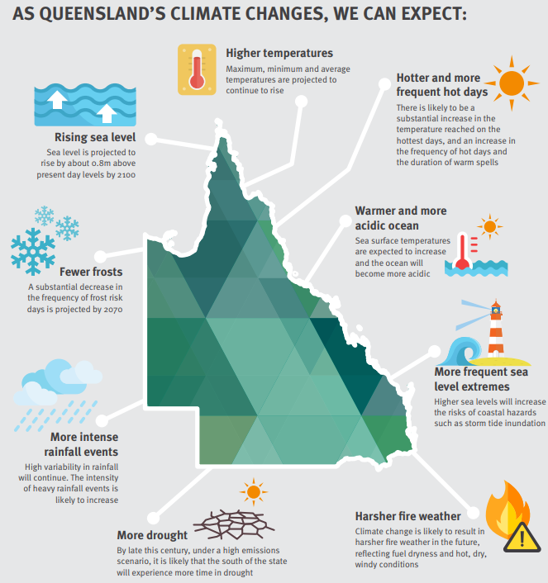
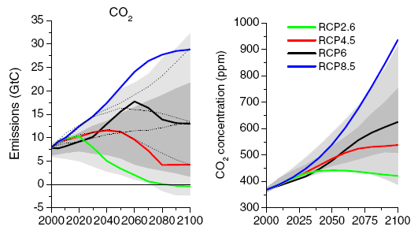

Slide 3
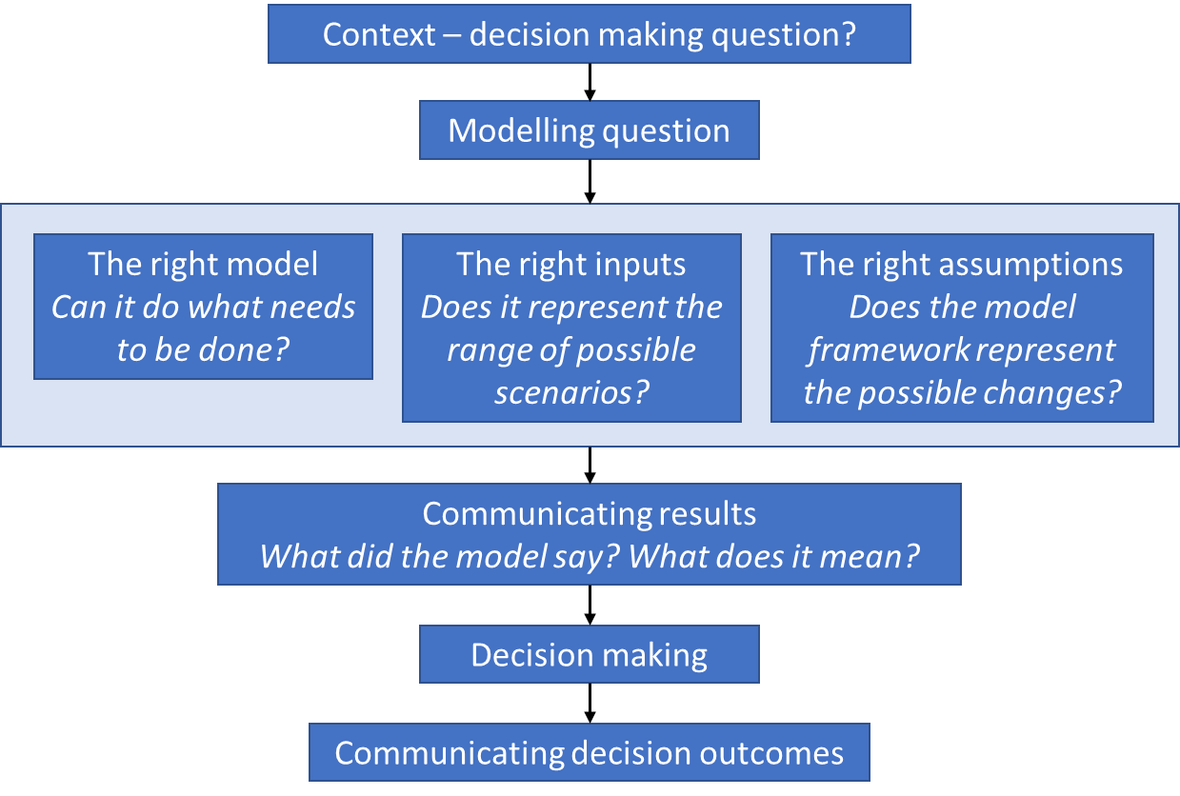

Slide 4
Some of the issues
From the critical review case studies
Understanding hydrologic non-stationarity
Suitability of current climate change data products
Evaluating ecosystem responses under altered climate
Land cover/pasture
Soil ecosystems
Water quality responses within receiving waters
Ecological responses within waterways
Extreme event changes
Frequency, intensity
Accounting for altered water use patterns
Storage demands
Irrigation usage
Cropping patterns

Slide 5
Evaluation criteria
The modelling question
Data inputs and forcing data
Conceptual process representation
Component models
Model outputs
Decision frameworks
How do we assess model suitability?
How do we do that consistently?
Where do we focus our effort?

Slide 6
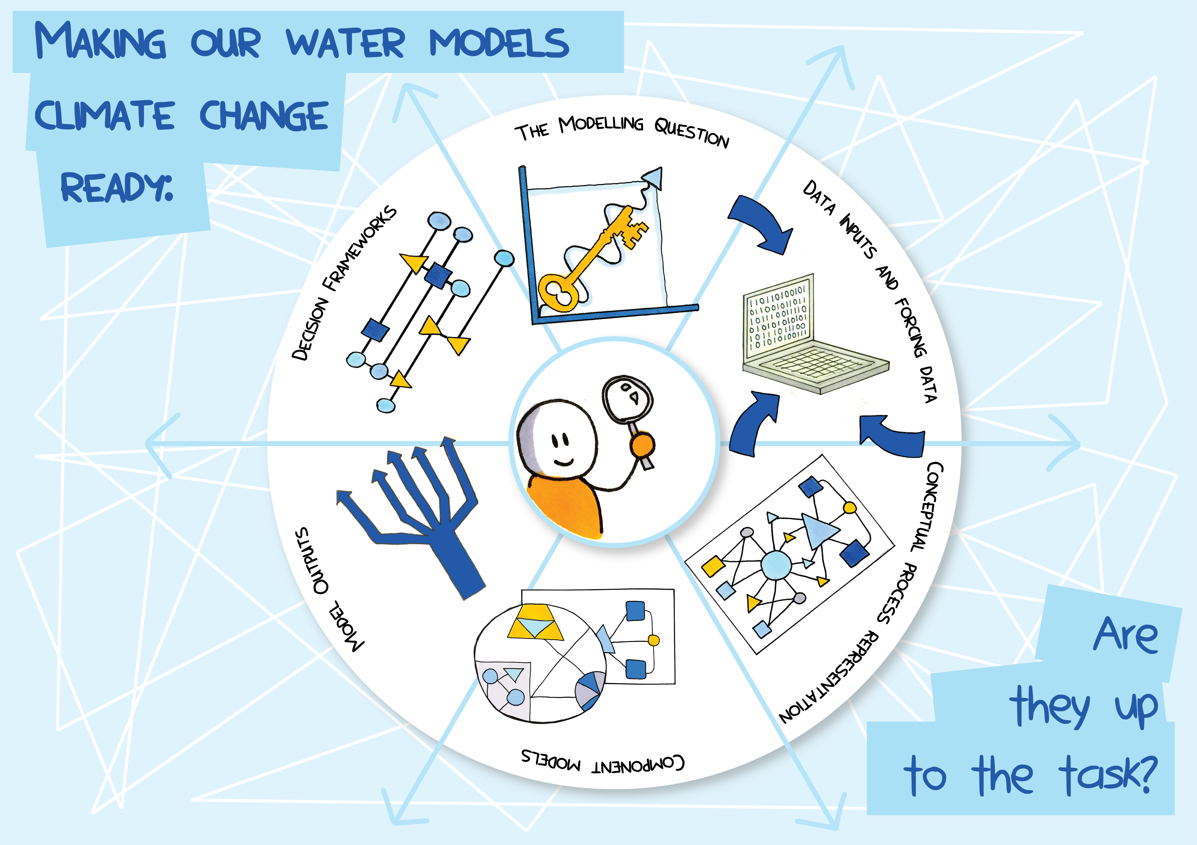

Slide 7

Think about:
Does the question ask about climate change or variability?
Could it be inferred that you need to know?
Is it about short or long time frames?
Do you need to understand changing climate drivers?

Slide 8

Many data sets to consider
May be directly related – e.g. temp, rainfall, evap
Climate variability or change may influence other data – crop water demands, vegetation cover, stream flow, economic activity
What scales are relevant (both temporal and spatial)
Historical, palaeo, future?

Slide 9
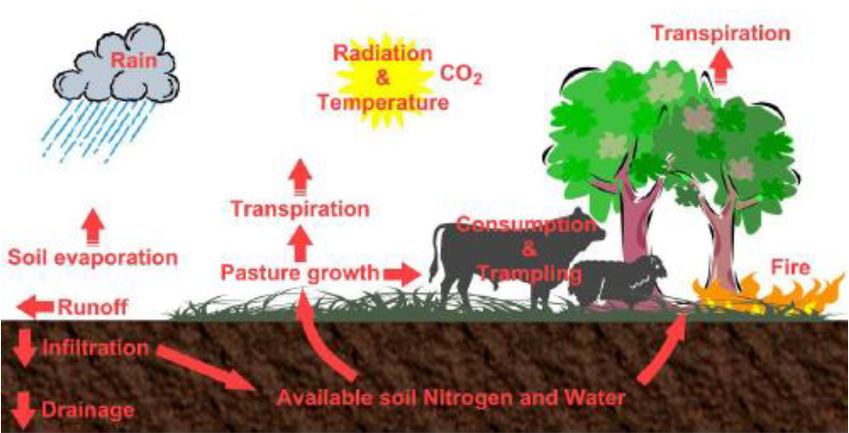
Conceptual models

Slide 10
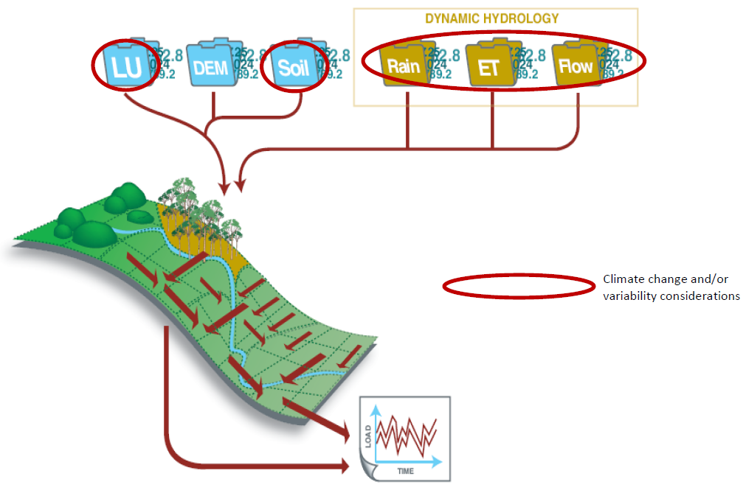

Climate change & Source model conceptualisation
Model input changes:
Rainfall
Evapotranspiration (ET)
Land use / land cover (?)
Potential structural changes:
Sediment export
Nutrient export
Source: Alluvium (2019), “Critical review of climate change and water modelling in Queensland – Final Report”, prepared collaboratively with CSIRO and University of Newcastle on behalf of the Queensland Water Modelling Network, Queensland Government, Brisbane.

Slide 11
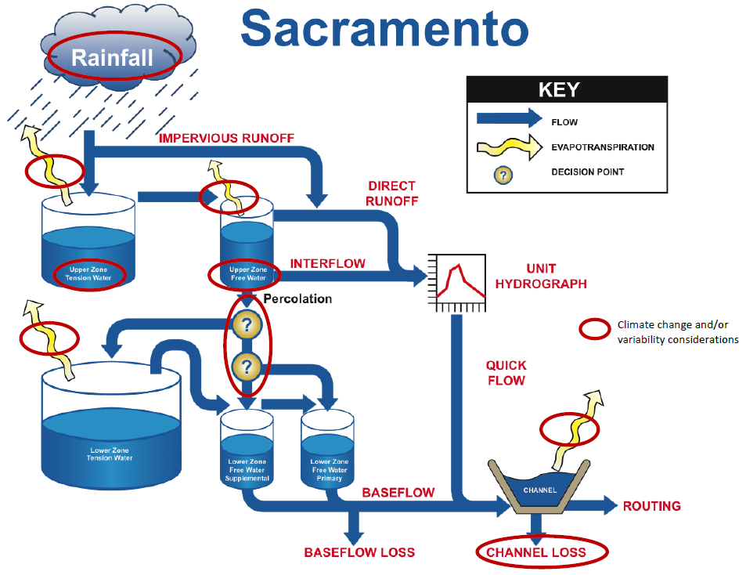
Climate change & Sacramento model conceptualisation
Model input changes:
Rainfall
Evapotranspiration (ET)
Potential structural changes:
Size of stores
Source: Alluvium (2019), “Critical review of climate change and water modelling in Queensland – Final Report”, prepared collaboratively with CSIRO and University of Newcastle on behalf of the Queensland Water Modelling Network, Queensland Government, Brisbane.

Slide 12
Climate change & Evapotranspiration (Penman-Monteith)
ET₀ = reference evapotranspiration [mm d⁻¹]
R_{n} = net radiation at the plant surface [MJ m⁻² d⁻¹]
G = soil heat flux density [MJ m⁻² d⁻¹]
T_{mean} = mean daily air temperature at 2 m height [°C]
u₂ = wind speed at 2 m height [m s⁻¹]
e_{s} = saturation vapour pressure [kPa]
e_{a} = actual vapour pressure [kPa]
Δ = slope of the vapour pressure curve [kPa °C⁻¹]
γ = psychrometric constant [kPa °C⁻¹]
a = 17.27, b = 237.3 (constants)
c_{p} = 1.013 × 10⁻³ MJ kg⁻¹ °C⁻¹ (specific heat)
P = atmospheric pressure [kPa]
ε = 0.622 (water vapour / dry air ratio)
RH = relative humidity

Slide 13
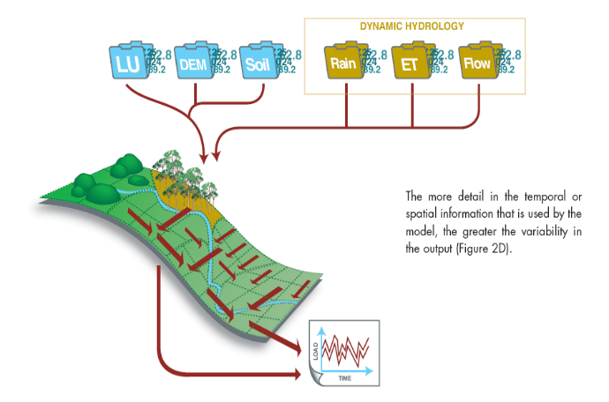
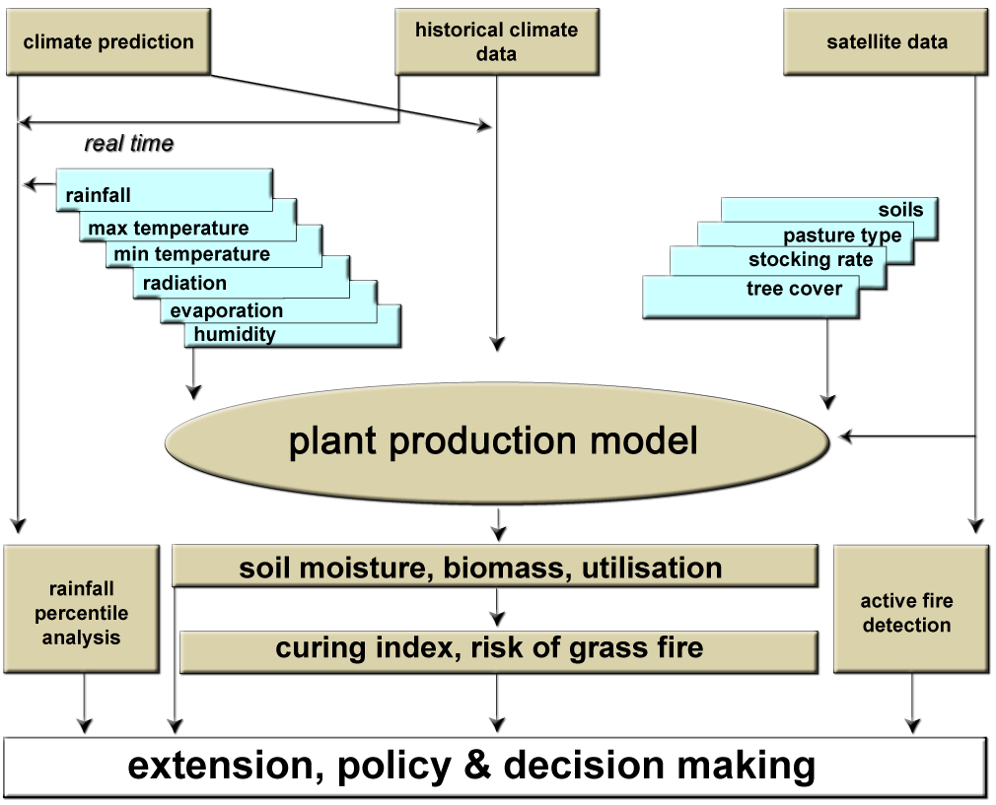
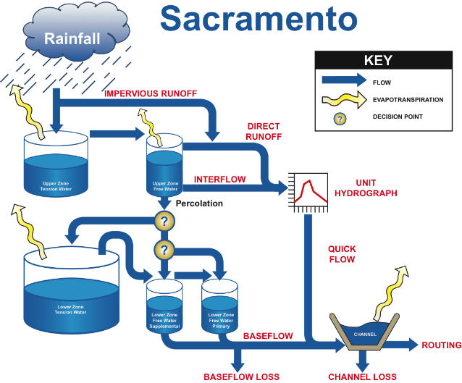
Case Studies
4 Case studies developed:
Catchment modelling
National pasture model
Basin Scale Water Resource modelling
City scale water supply yield

Slide 14
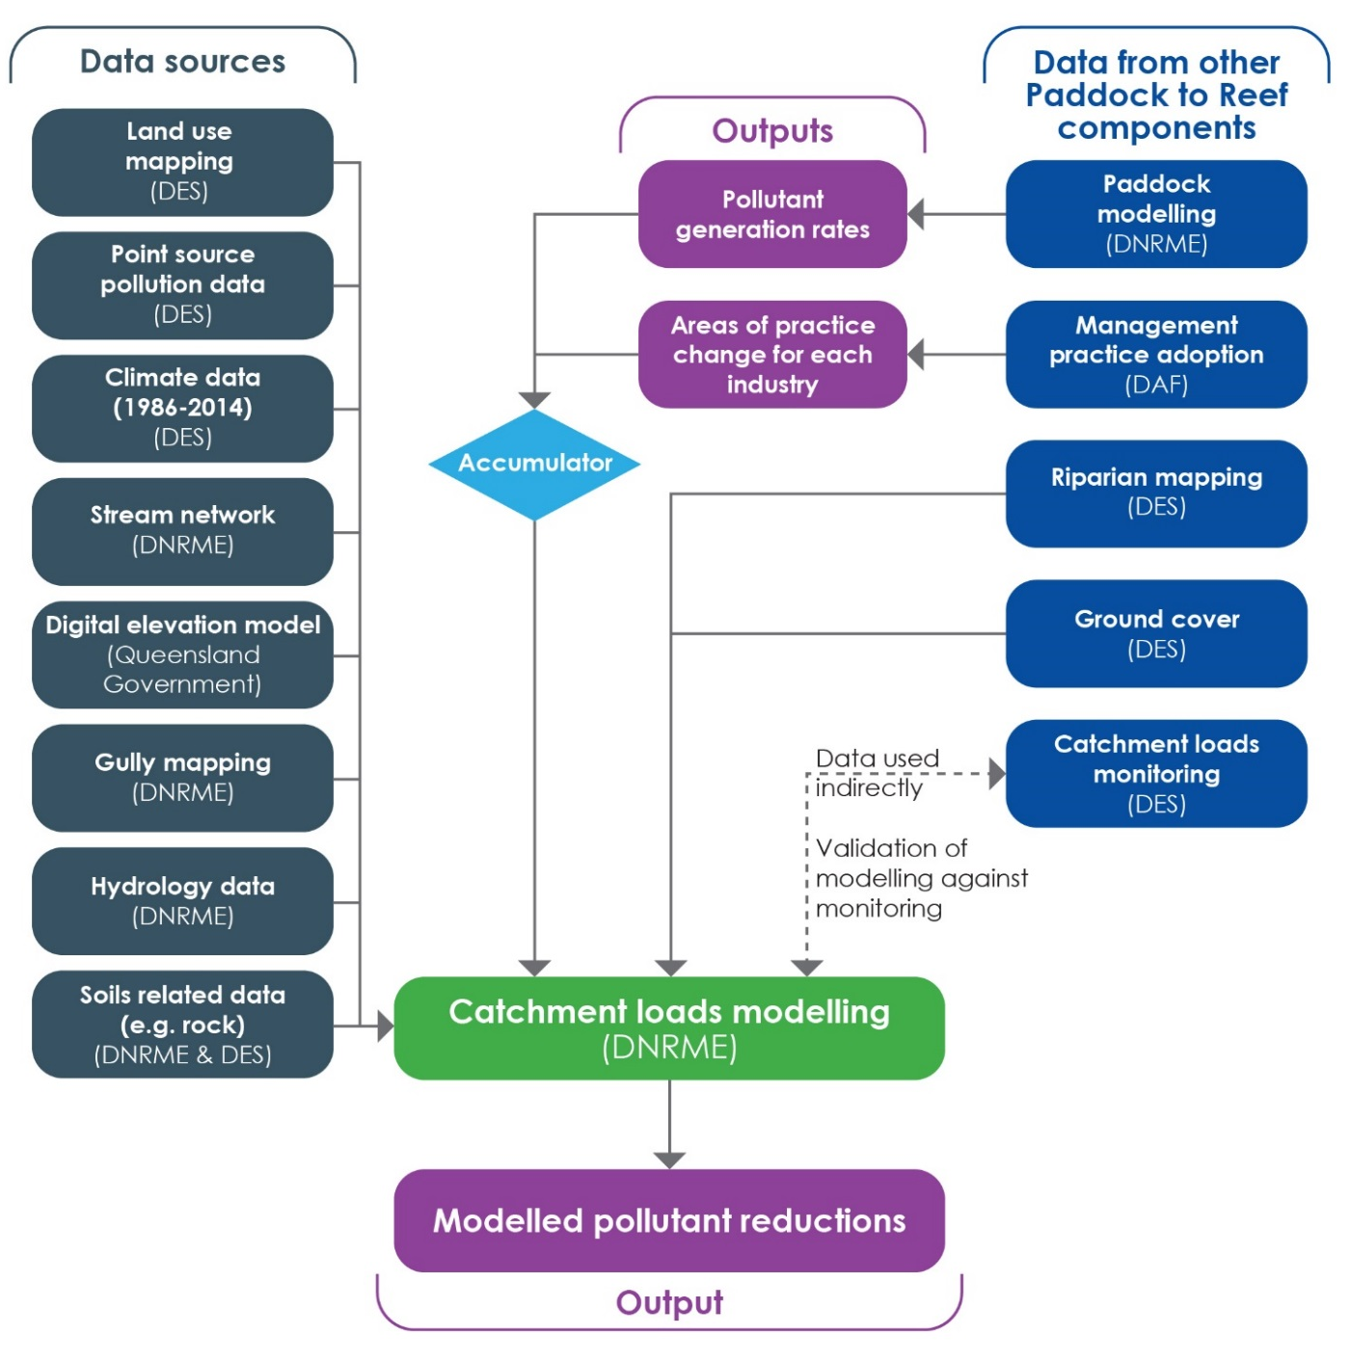
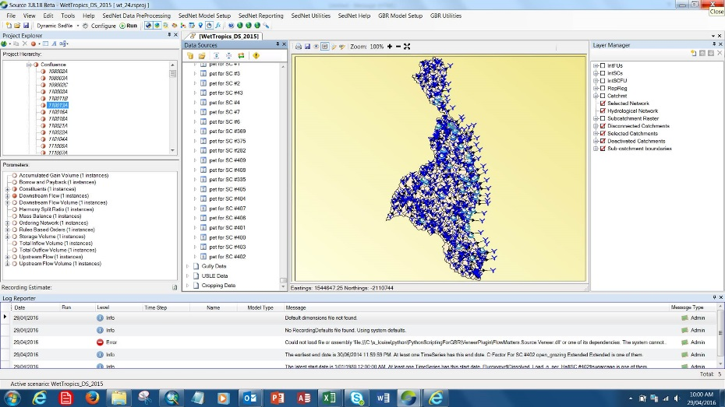
Paddock to Reef

Slide 15
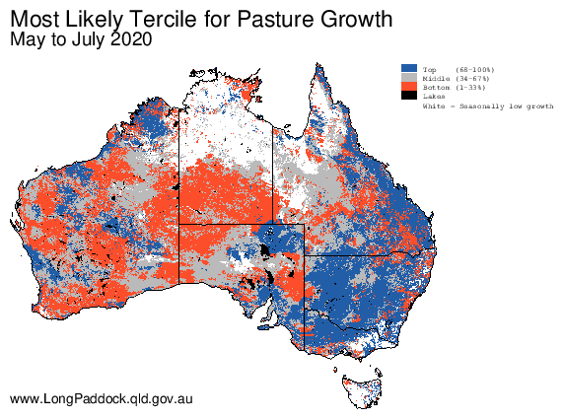
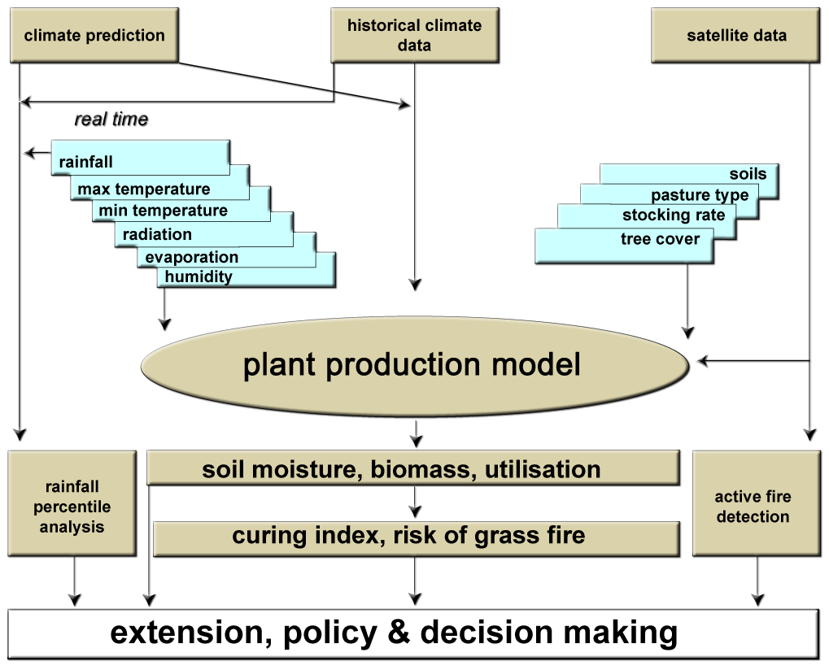
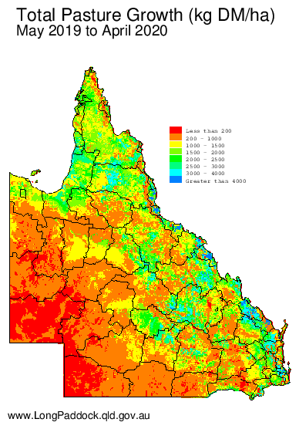
AussieGRASS

Slide 16
Evaluation criteria now available
Will be up on the QWMN website soon
Its intended to guide understanding
Make sure to not only rely on the score
Individual criteria elements can be critical
It is also a developing space, so these criteria may change
Overall, we hope they help understand whether your models are up to the task!

Slide 17

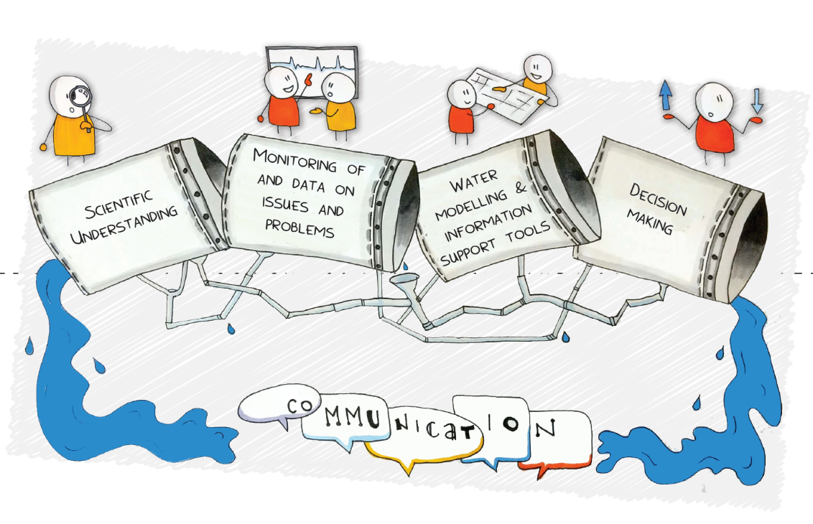

Lets stay connected and lookout for follow up activity

